Slide 1


PowerShell Remoting:
Don’t fear the Windows Remote Shell
Mike Kanakos
Active Directory Engineer: MetLife

Slide 2

$AboutMe = Get-SpeakerInfo
Metlife Active Directory Engineer
Research-Triangle PSUG Co-Leader (1300 members!)
PowerShell.org Director of Community Engagement
Blog: www.networkadm.in
Writer: 4sysops.com & ipswitch.com
Contributor: PowerShell Conference Book
vol. 1 & vol. 2
Twitter: @MikeKanakos
Email: mkanakos@gmail.com
GitHub: github.com/compwiz32

Slide 3

Do you trust this client?

Slide 4
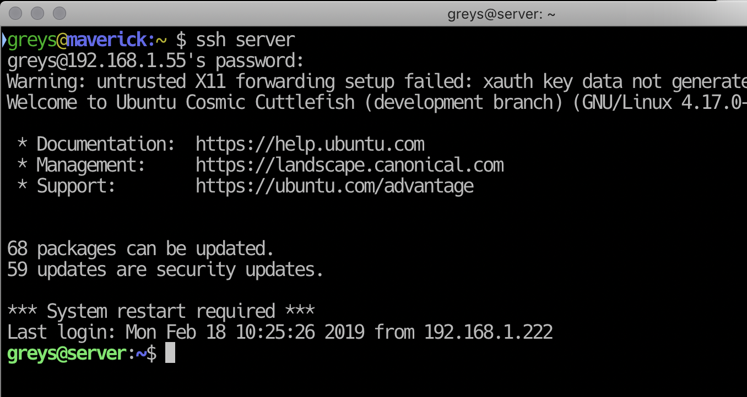

Slide 5
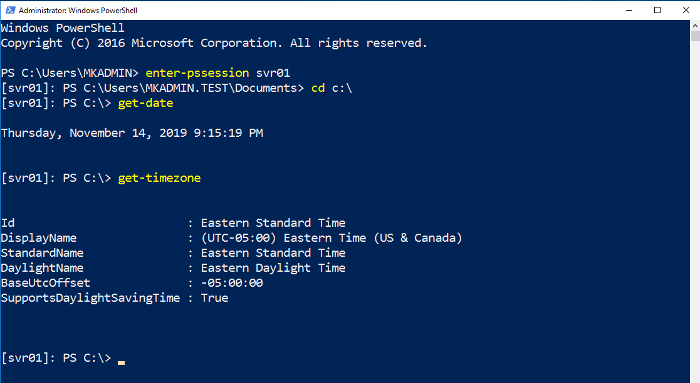

Slide 6
Why?

Slide 7
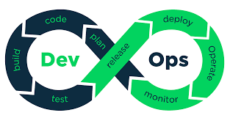

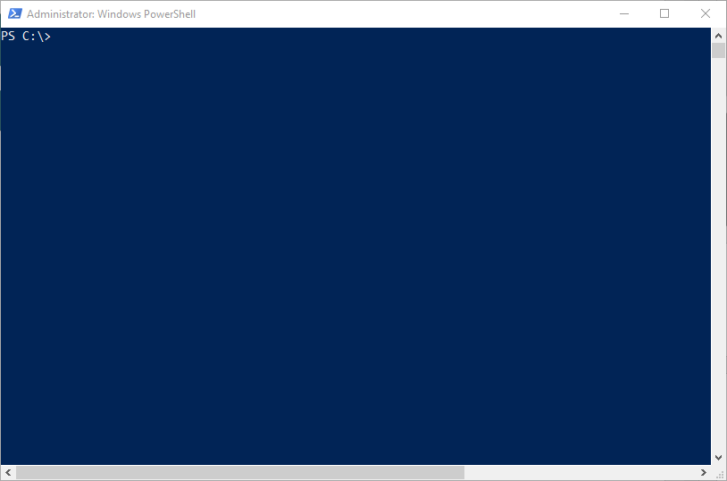


The IT world has changed…

Slide 8
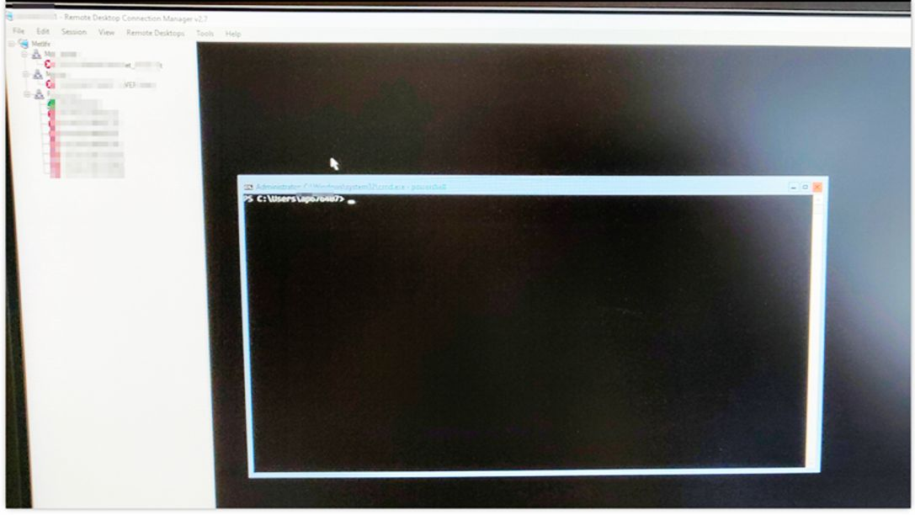
Server 2016 core

Slide 9


Is this your org?
“I would like to enable PS Remoting for our domain computers…”
Are you crazy?
What if we get owned?
No!

Slide 10

What is PowerShell Remoting?
Connecting to a remote computer via Windows Remoting
CIM cmdlets, PSSession, Invoke-Command
WinRM uses the WSMan protocol (http: 5985 & https:5986)
All connections are encrypted by default

Slide 11

Why use PSRemoting?
Designed to work with Active Directory
Kerberos Authentication
All connections encrypted / Windows Firewall Aware
Robust logging
JEA profiles (Think RBAC)
Supports Certificates
More secure than anything else from Microsoft

Slide 12
PS cmdlets that support remoting
PS C:\> get-command -Noun *cim*
CommandType Name
---------- -------
Cmdlet Get-CimAssociatedInstance
Cmdlet Get-CimClass
Cmdlet Get-CimInstance
Cmdlet Get-CimSession
Cmdlet Invoke-CimMethod
Cmdlet New-CimInstance
Cmdlet New-CimSession
Cmdlet New-CimSessionOption
Cmdlet Register-CimIndicationEvent
Cmdlet Remove-CimInstance
Cmdlet Remove-CimSession
Cmdlet Set-CimInstance
Cmdlet Invoke-Command
PS C:\> get-command -Noun *pssess*
CommandType Name
----------- ------
Cmdlet Connect-PSSession
Cmdlet Disable-PSSessionConfiguration
Cmdlet Disconnect-PSSession
Cmdlet Enable-PSSessionConfiguration
Cmdlet Enter-PSSession
Cmdlet Exit-PSSession
Cmdlet Export-PSSession
Cmdlet Get-PSSession
Cmdlet Get-PSSessionCapability
Cmdlet Get-PSSessionConfiguration
Cmdlet Import-PSSession
Cmdlet New-PSSession
Cmdlet New-PSSessionConfigurationFile
Cmdlet New-PSSessionOption
Cmdlet Receive-PSSession
Cmdlet Register-PSSessionConfiguration
Cmdlet Remove-PSSession
Cmdlet Set-PSSessionConfiguration
Cmdlet Test-PSSessionConfigurationFile
Cmdlet Unregister-PSSessionConfiguration

Slide 13


How does Remoting work?
Local Computer
http 5985 / https 5986
Remote Computer
Encrypted connection (256 bit key)
Local PowerShell session authenticates against remote client. - Enter-PSSession
- Invoke-Command
- Any CIM cmdlets
01
Commands typed on the local system are sent to a remote computer and executed locally ON THE REMOTE SYSTEM.
03
The remote system EXECUTES the commands locally and sends the results back to the local system.
04
Identity confirmed. Privileges granted based on local group membership on remote PC
PS session created on remote system via WS-MAN / WinRM
02

Slide 14
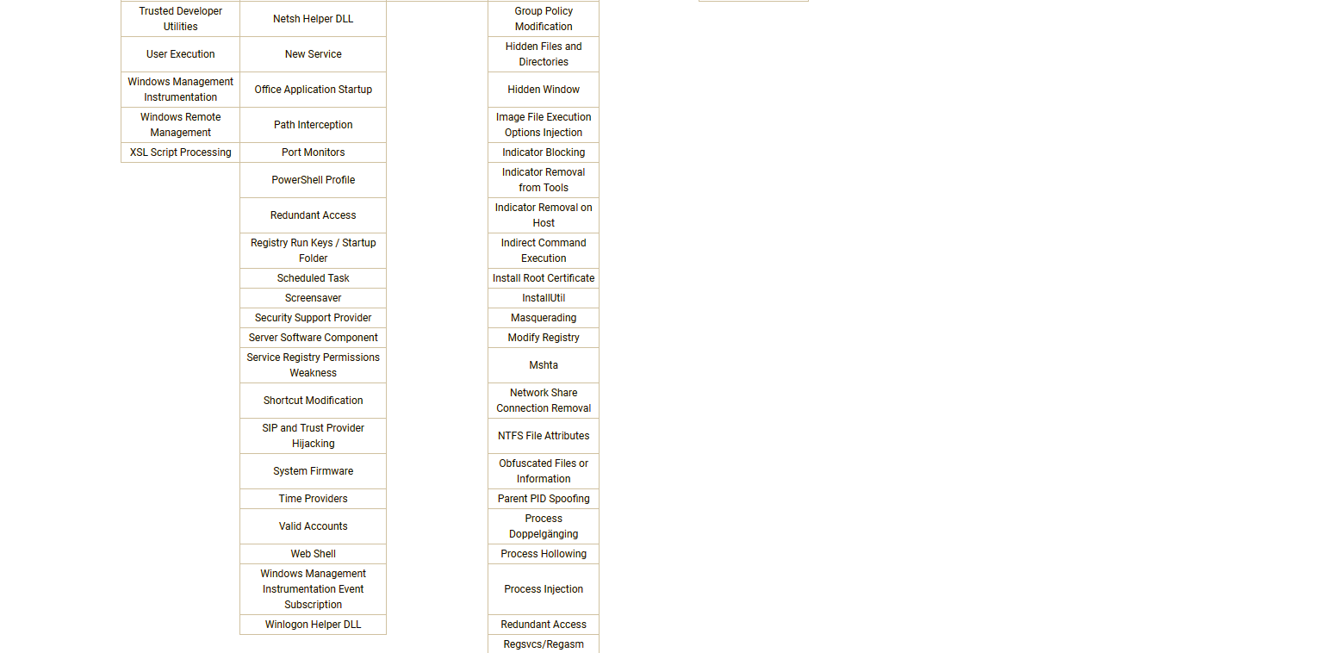
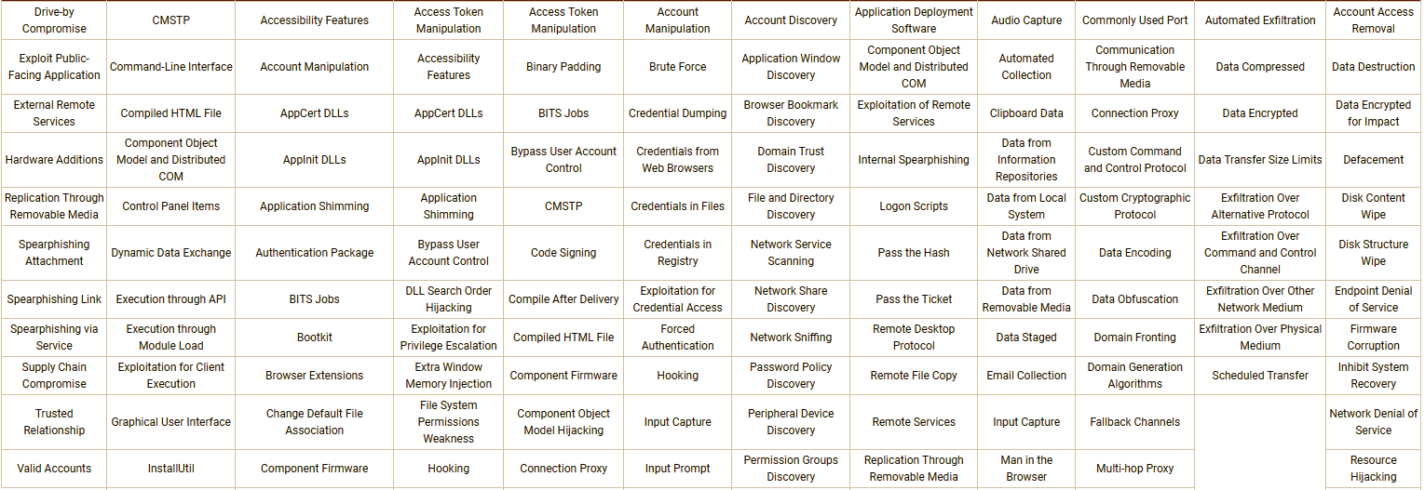
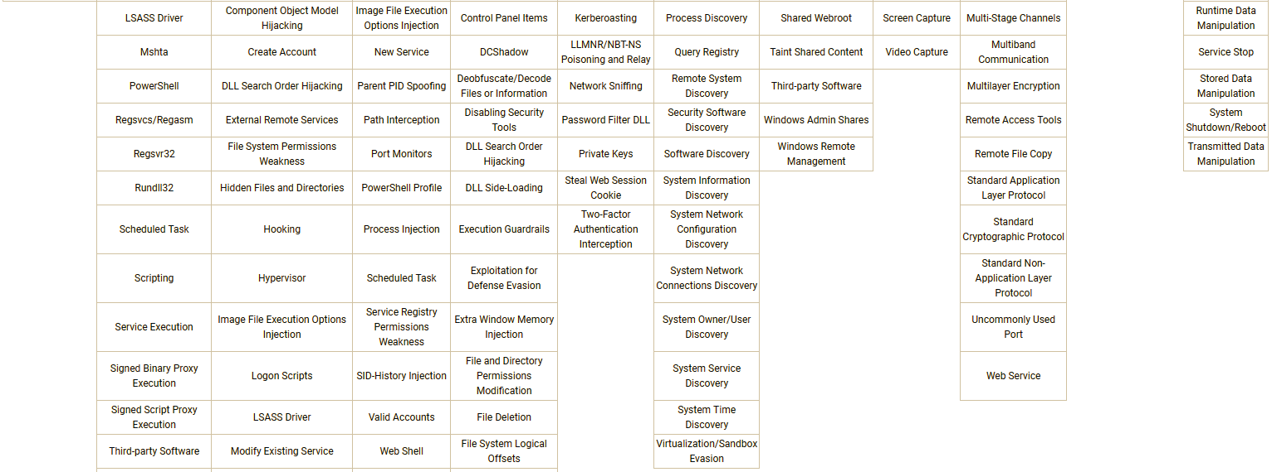

Slide 15
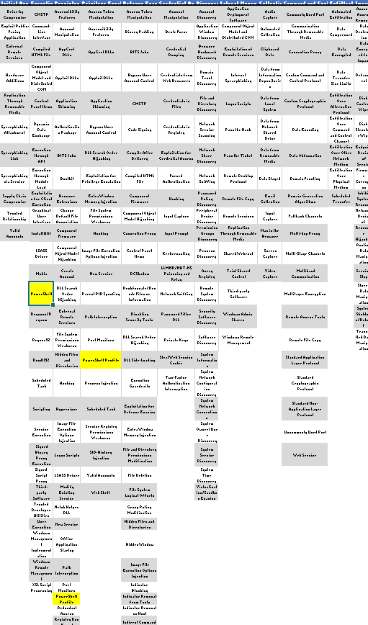

Slide 16

What happens when PowerShell remoting is turned off?

Slide 17



PSREMOTING: “The Road to a Remote Computer”
PS Remoting is connection & HANDSHAKE between nodes

Slide 18
PowerShell Authentication
01
02
PS Remoting was designed to work with Active Directory
Authentication occurs using Kerberos for AD Domain-joined computers
01
02
Local PowerShell session authenticates against remote client. - Enter-PSSession
- Invoke-Command
- Any CIM cmdlets
Identity confirmed. Privileges granted based on local group membership on remote PC
PS session created on remote system via WS-MAN / WinRM

Slide 19
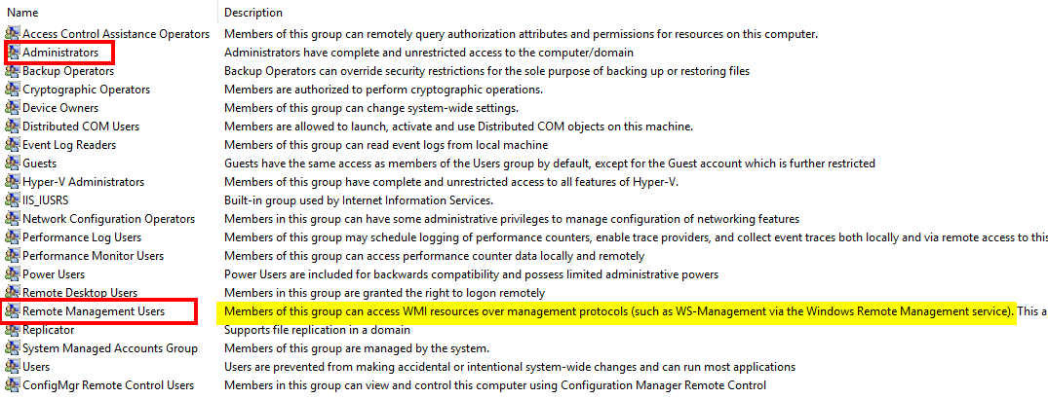
Local Group Membership
Remote Management Users = Read Access to client

Slide 20
Enabling PSREMOTING via Group Policy
Enabling WINRM Service
Setting WINRM to Auto Start
Allow WinRM through the client firewall
Notes:
Via GPO ia how most people will do this…
3 steps – super simple

Slide 21
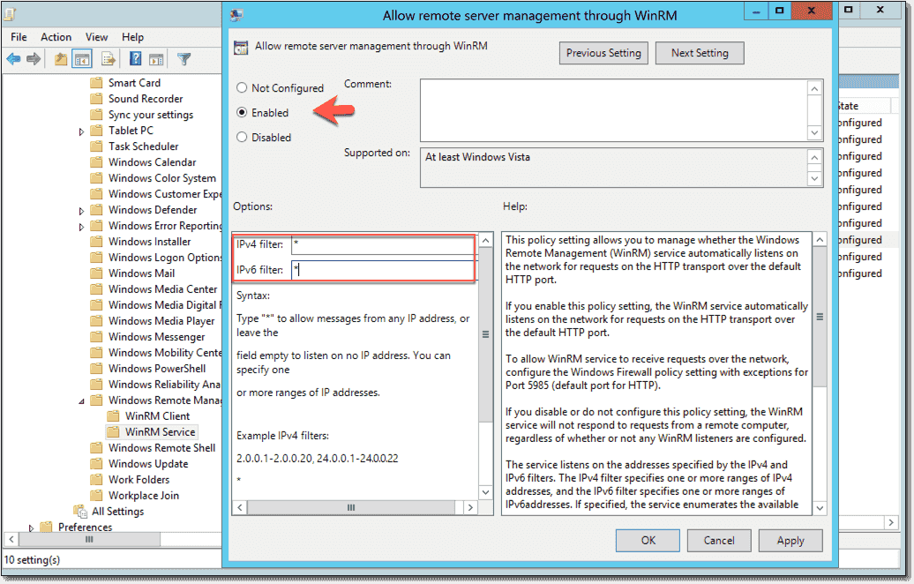
Enabling PSREMOTING with Group Policy
Computer Configuration > Policies > Administrative Templates > Windows Components > Windows Remote Management (WinRM) > WinRM Service
Notes:
Enable remote management (enable /disable)
IP filtering… let’s come back to this…

Slide 22
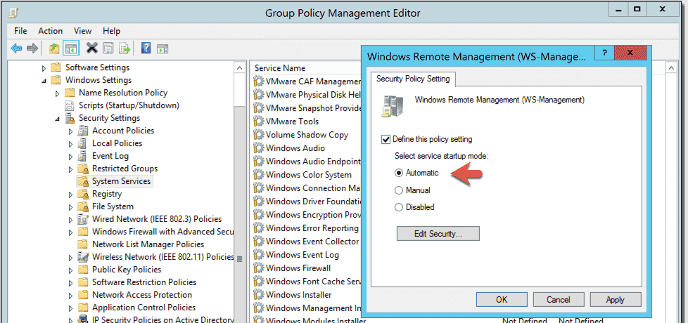
Enabling PSREMOTING with Group Policy
Computer Configuration > Policies > Windows Settings > Security Settings > System Services > Windows Remote Management (WS-Management)
Notes:
Service startup - enable / disable

Slide 23
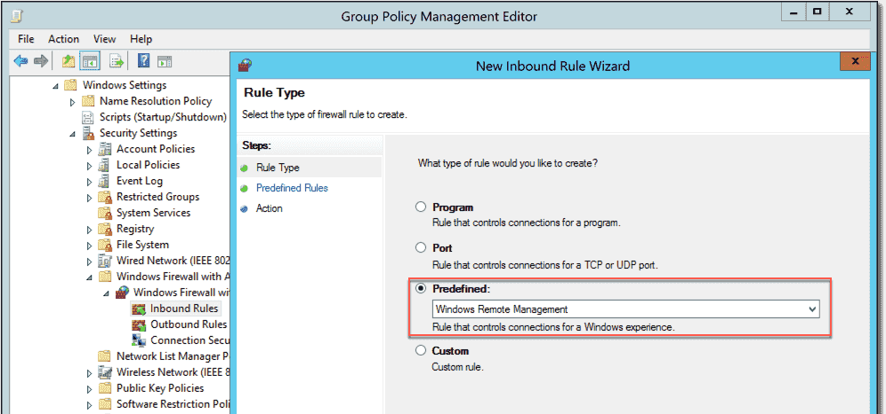
Enabling PSREMOTING with Group Policy
Computer Configuration >
Policies >
Windows Settings > Security Settings >
Windows Firewall with Advanced Security
Notes:
Poke a hole in firewall… super simple.. Predefined rule…

Slide 24
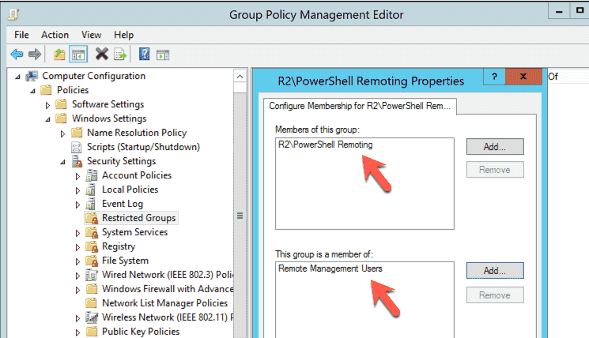
Controlling access to remote nodes
Computer Configuration > Policies > Security Settings > Restricted Groups
Notes:
Make an AD group (top box)
Add to an existing local group (bottom box)

Slide 25
PSRemoting & IP Filtering
Notes:
Enabling WINRM
Filtering IP sources (allow connections through firewall)
This is where it gets interesting…
Talk about jump boxes and clients that do not need to initiate connections
Combo of IP filtering at firewall and remote management users group is a powerful way to limit connections.

Slide 26
Enabling PSREMOTING: Summary
Enable WINRM Service and set to auto start
Configure Windows Firewall Exception
Decide who gets access
Decide where connections can be initiated from
Decide how you will implement settings (cmd line, GPO or both)
Notes:
Knowing this process builds trust
Trust allows the security team or exec mgmt to do the things you ask for

Slide 27
Questions?

Slide 28

JEA: Just Enough Administration
Role Based Access for PowerShell
Create “Role Capability Files (ie Roles)”
Create “Session Config Files (ie ACL’s)”
Deploy via Group Policy
Role Capability File + Session Config files =

Slide 29






JEA: Just Enough Administration
Session Config (who can connect)
Role Capability File
(what cmdlets can be run)

Slide 30
Logging Powershell Activity
Module Logging
Script Block Logging
Transcription
Notes:
No right combination of settings by default.
You have to figure whats right for you and your org

Slide 31
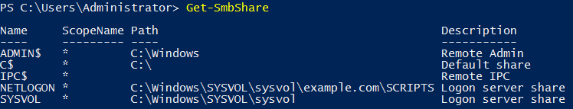
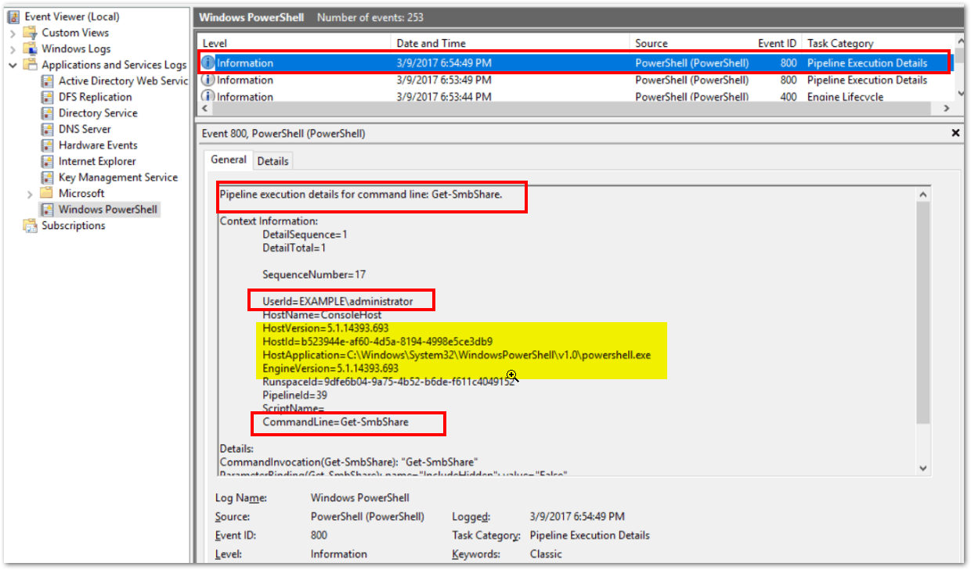
Powershell Logging: Module Logging

Slide 32

Powershell Logging: Script block Logging
Script Block logging records blocks of code as they are executed by the PowerShell engine
Events are written to the Windows PowerShell log (Event IDs# 4104, 4105 & 4106)
PowerShell 5.0 automatically logs code blocks if the block’s contents match on a list of suspicious commands or scripting techniques, even if script block logging is not enabled.
Produces less logs than Module Logging but still can be noisy.

Slide 33
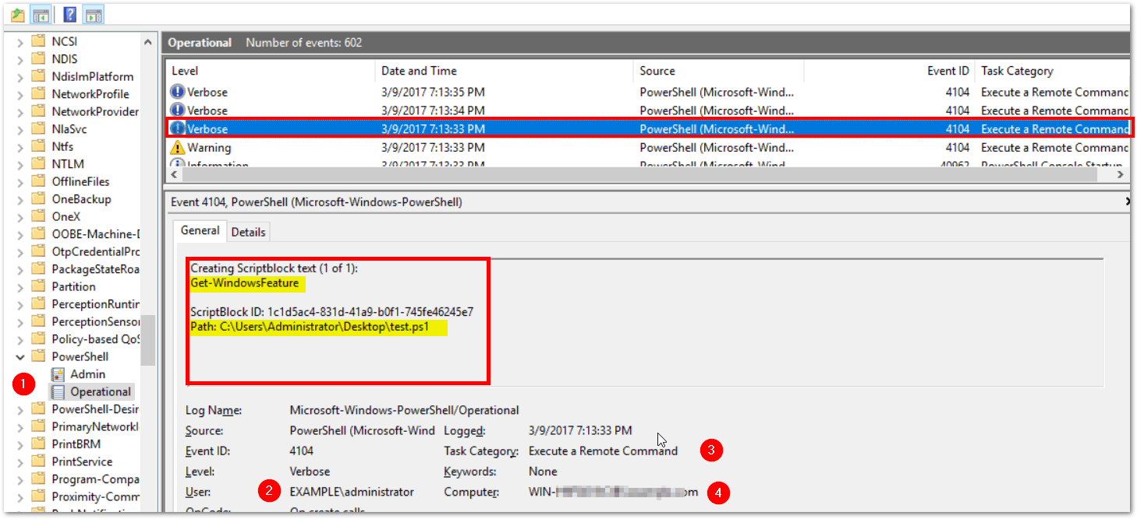
Powershell Logging: Scriptblock Logging

Slide 34

Powershell Logging: TRANSCRIPTION
Transcription creates a unique record of every PowerShell session, including all input and output, exactly as it appears in the session.
Transcripts are written to text files, broken out by user and session.
WARNING: Transcription will capture API Keys, SQL Strings, License Keys, etc. to the log in clear text (but not passwords)!

Slide 35
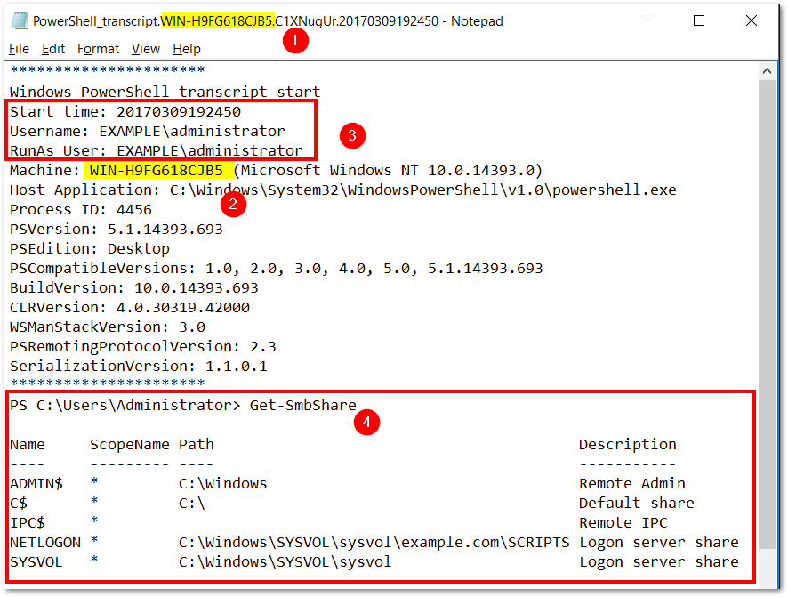
PowerShell Logging: Transcription

Slide 36
PSLogging: Summary
Three different logging options
Two options write to event logs
Transcription produces flat text files
Logging can fill up the eventlog quickly. Increase log size to 1GB or greater if possible
The right combination of logging is determined by you

Slide 37
Questions?

Slide 38

Why use PSRemoting?
Encryption
JEA Profiles (RBAC)
Robust Logging
Good End Node Security
Trusted Authentication

Slide 39
Wrapping it all up
How secure PowerShell Remoting is depends on your security posture on your end nodes
PS Remoting uses secure protocols and AD authentication
PS Remoting can be configured easily via Group Policy
You can capture nearly every PS command typed into a PowerShell cmd prompt from any PC in your domain if you choose so. But doing so has an impact.
There is no one size fits all setting for PS Remoting & Logging
You should be ENCOURAGING your admins to use PS Remoting!

Slide 40
Thank You

Slide 41
Icons

